Slide 1
RESULTS STORYLINE
Acute Netrin-1 produces a 5-min transcriptional pulse that reverses by 15 min
A results-focused version of the handmade deck: cleaner sequence, unified layout, and fewer detours.
32
19
313
r = -0.991
5v0 DEGs, relaxed
LRT time-varying genes
5v0 GO BP terms
5v0 vs 15v5 pathway mirror
Result logic: QC supports interpretability -> 5-min DEGs define acute anchors -> LRT captures time-dependent genes -> GSEA reveals coordinated pathway reversal.
Acute Netrin-1 RNA-seq results
01
Notes:
Open with the result, not the methods. This deck is organized around the evidence chain in the handmade slides.

Slide 2
ANALYSIS MAP
The three contrasts ask onset, reversal and return-to-baseline questions
This slide gives the audience the vocabulary used throughout the results.
Vehicle
5 min
15 min
5v0
15v5
15v0
>
>
>
>
>
PBS control
acute Netrin-1
later Netrin-1
onset vs Vehicle
reversal vs 5 min
return vs Vehicle
Statistical model: DESeq2 ~ replicate + timepoint; batch correction was used only for PCA visualization, not for DE testing.
Source: handmade methods slides and THESIS_writing_pack.md
02
Notes:
Keep this concise. It replaces several scattered method statements from the handmade version.

Slide 3
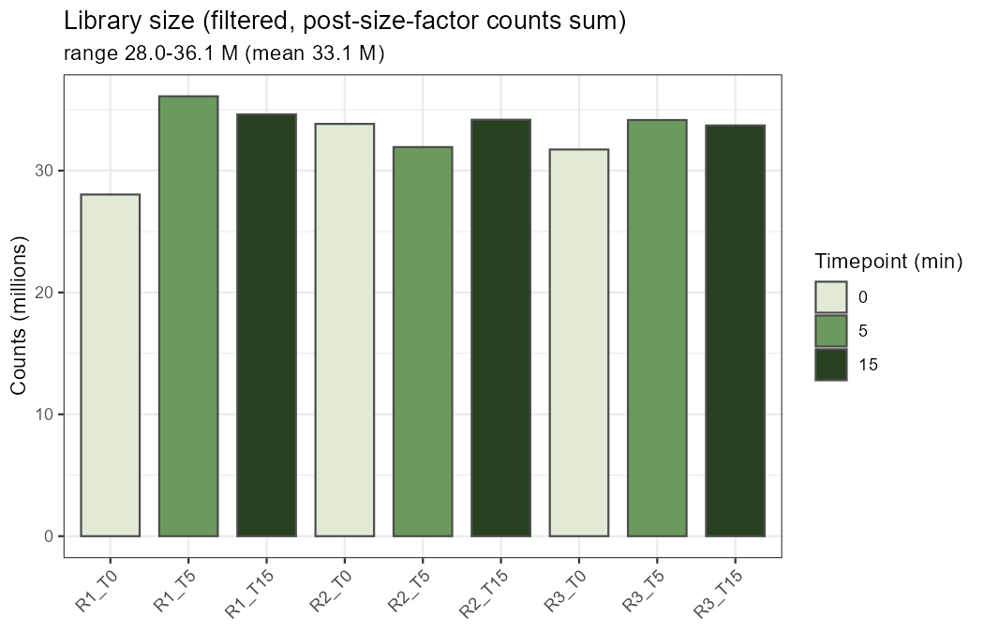
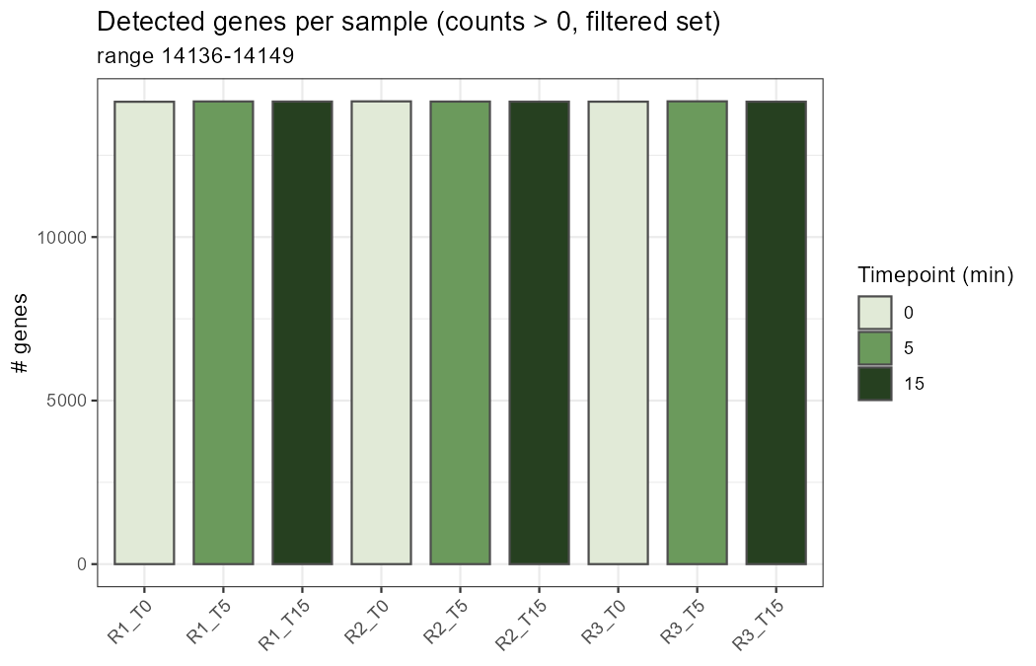
FILTERING AND SAMPLE QC
Filtering retains 14,161 genes and sample depth is comparable
The first result block establishes that downstream differences are interpretable.
Two-step filtering: 32,623 quantified genes -> 14,161 genes for differential expression.
Source: results/01_QC and handmade slide 1
03
Notes:
This combines handmade filtering with the two QC plots so the audience sees both gene filtering and sample-level QC.

Slide 4
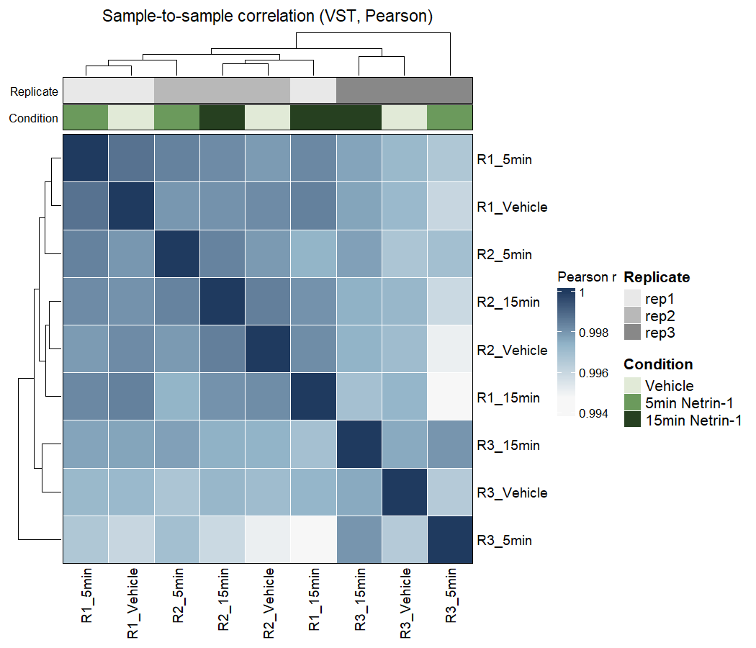
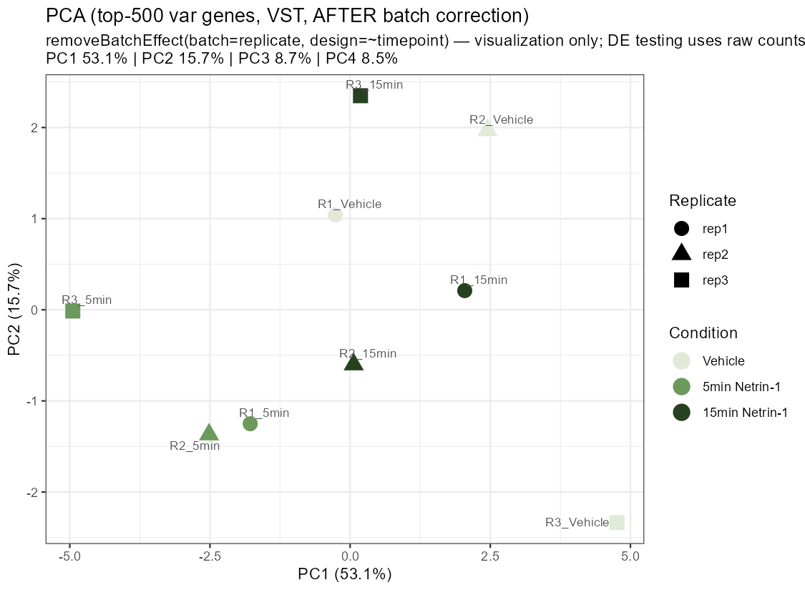
REPLICATE AND TIMEPOINT STRUCTURE
Replicate effects are visible, but corrected PCA reveals timepoint separation
This justifies modeling replicate and interpreting the acute timepoint signal.
Source: results/01_QC
04
Notes:
State clearly that replicate is modeled statistically; corrected PCA is only a visualization.

Slide 5
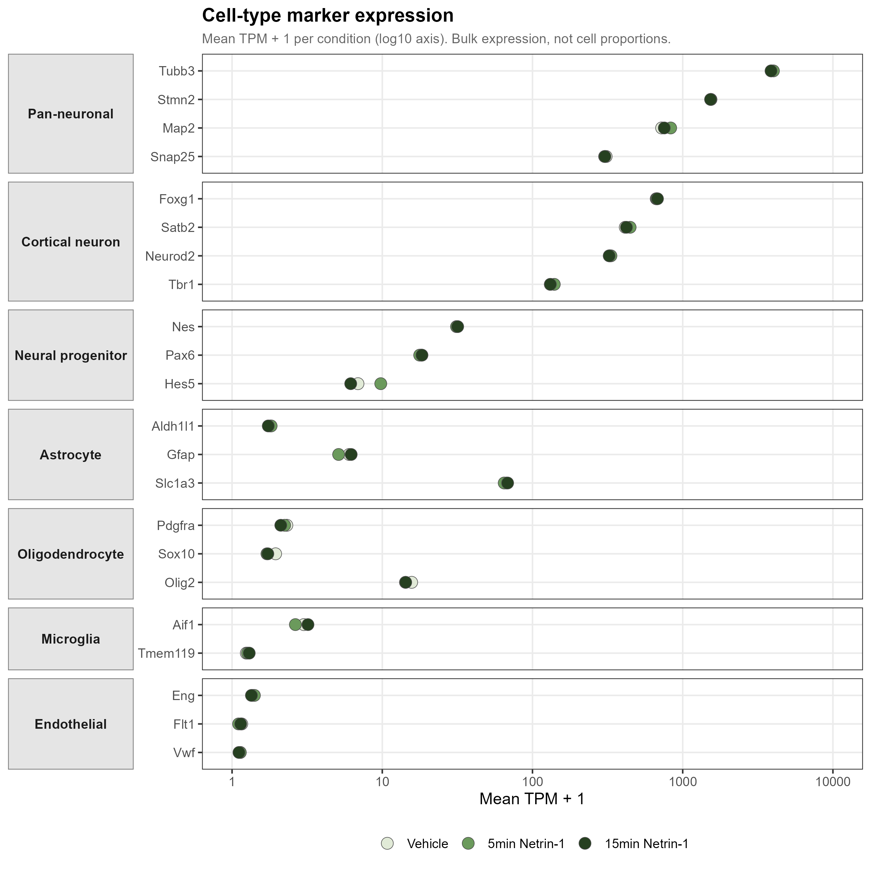
CULTURE COMPOSITION
Marker expression supports neuron-dominant, composition-stable cultures
This rules against a simple cell-composition explanation for the acute signal.
Interpretation
- Pan-neuronal markers are high.
- Glial/endothelial markers remain low.
- Marker profiles are stable across conditions.
Source: results/02_composition
05
Notes:
This slide preserves handmade slide 4 but makes the conclusion more compact.

Slide 6
DEG OVERVIEW
The largest single-gene response is detected at 5 min
15v5 is the key contrast for reversal; 15v0 is comparatively quiet at DEG level.
Contrast | Question | Relaxed | Strict | Direction
5v0 | onset | 32 | 5 | 14 up / 18 down
15v5 | reversal | 6 | 2 | 6 up / 0 down
15v0 | return | 1 | 1 | 0 up / 1 down
LRT | any time effect | 19 | - | time-varying genes
Takeaway: single-gene changes are modest but time-structured, motivating LRT and GSEA as the main result layers.
Source: DEG CSV files and handmade slide 5
06
Notes:
This cleans up the DEG table and gives it one interpretation.

Slide 7
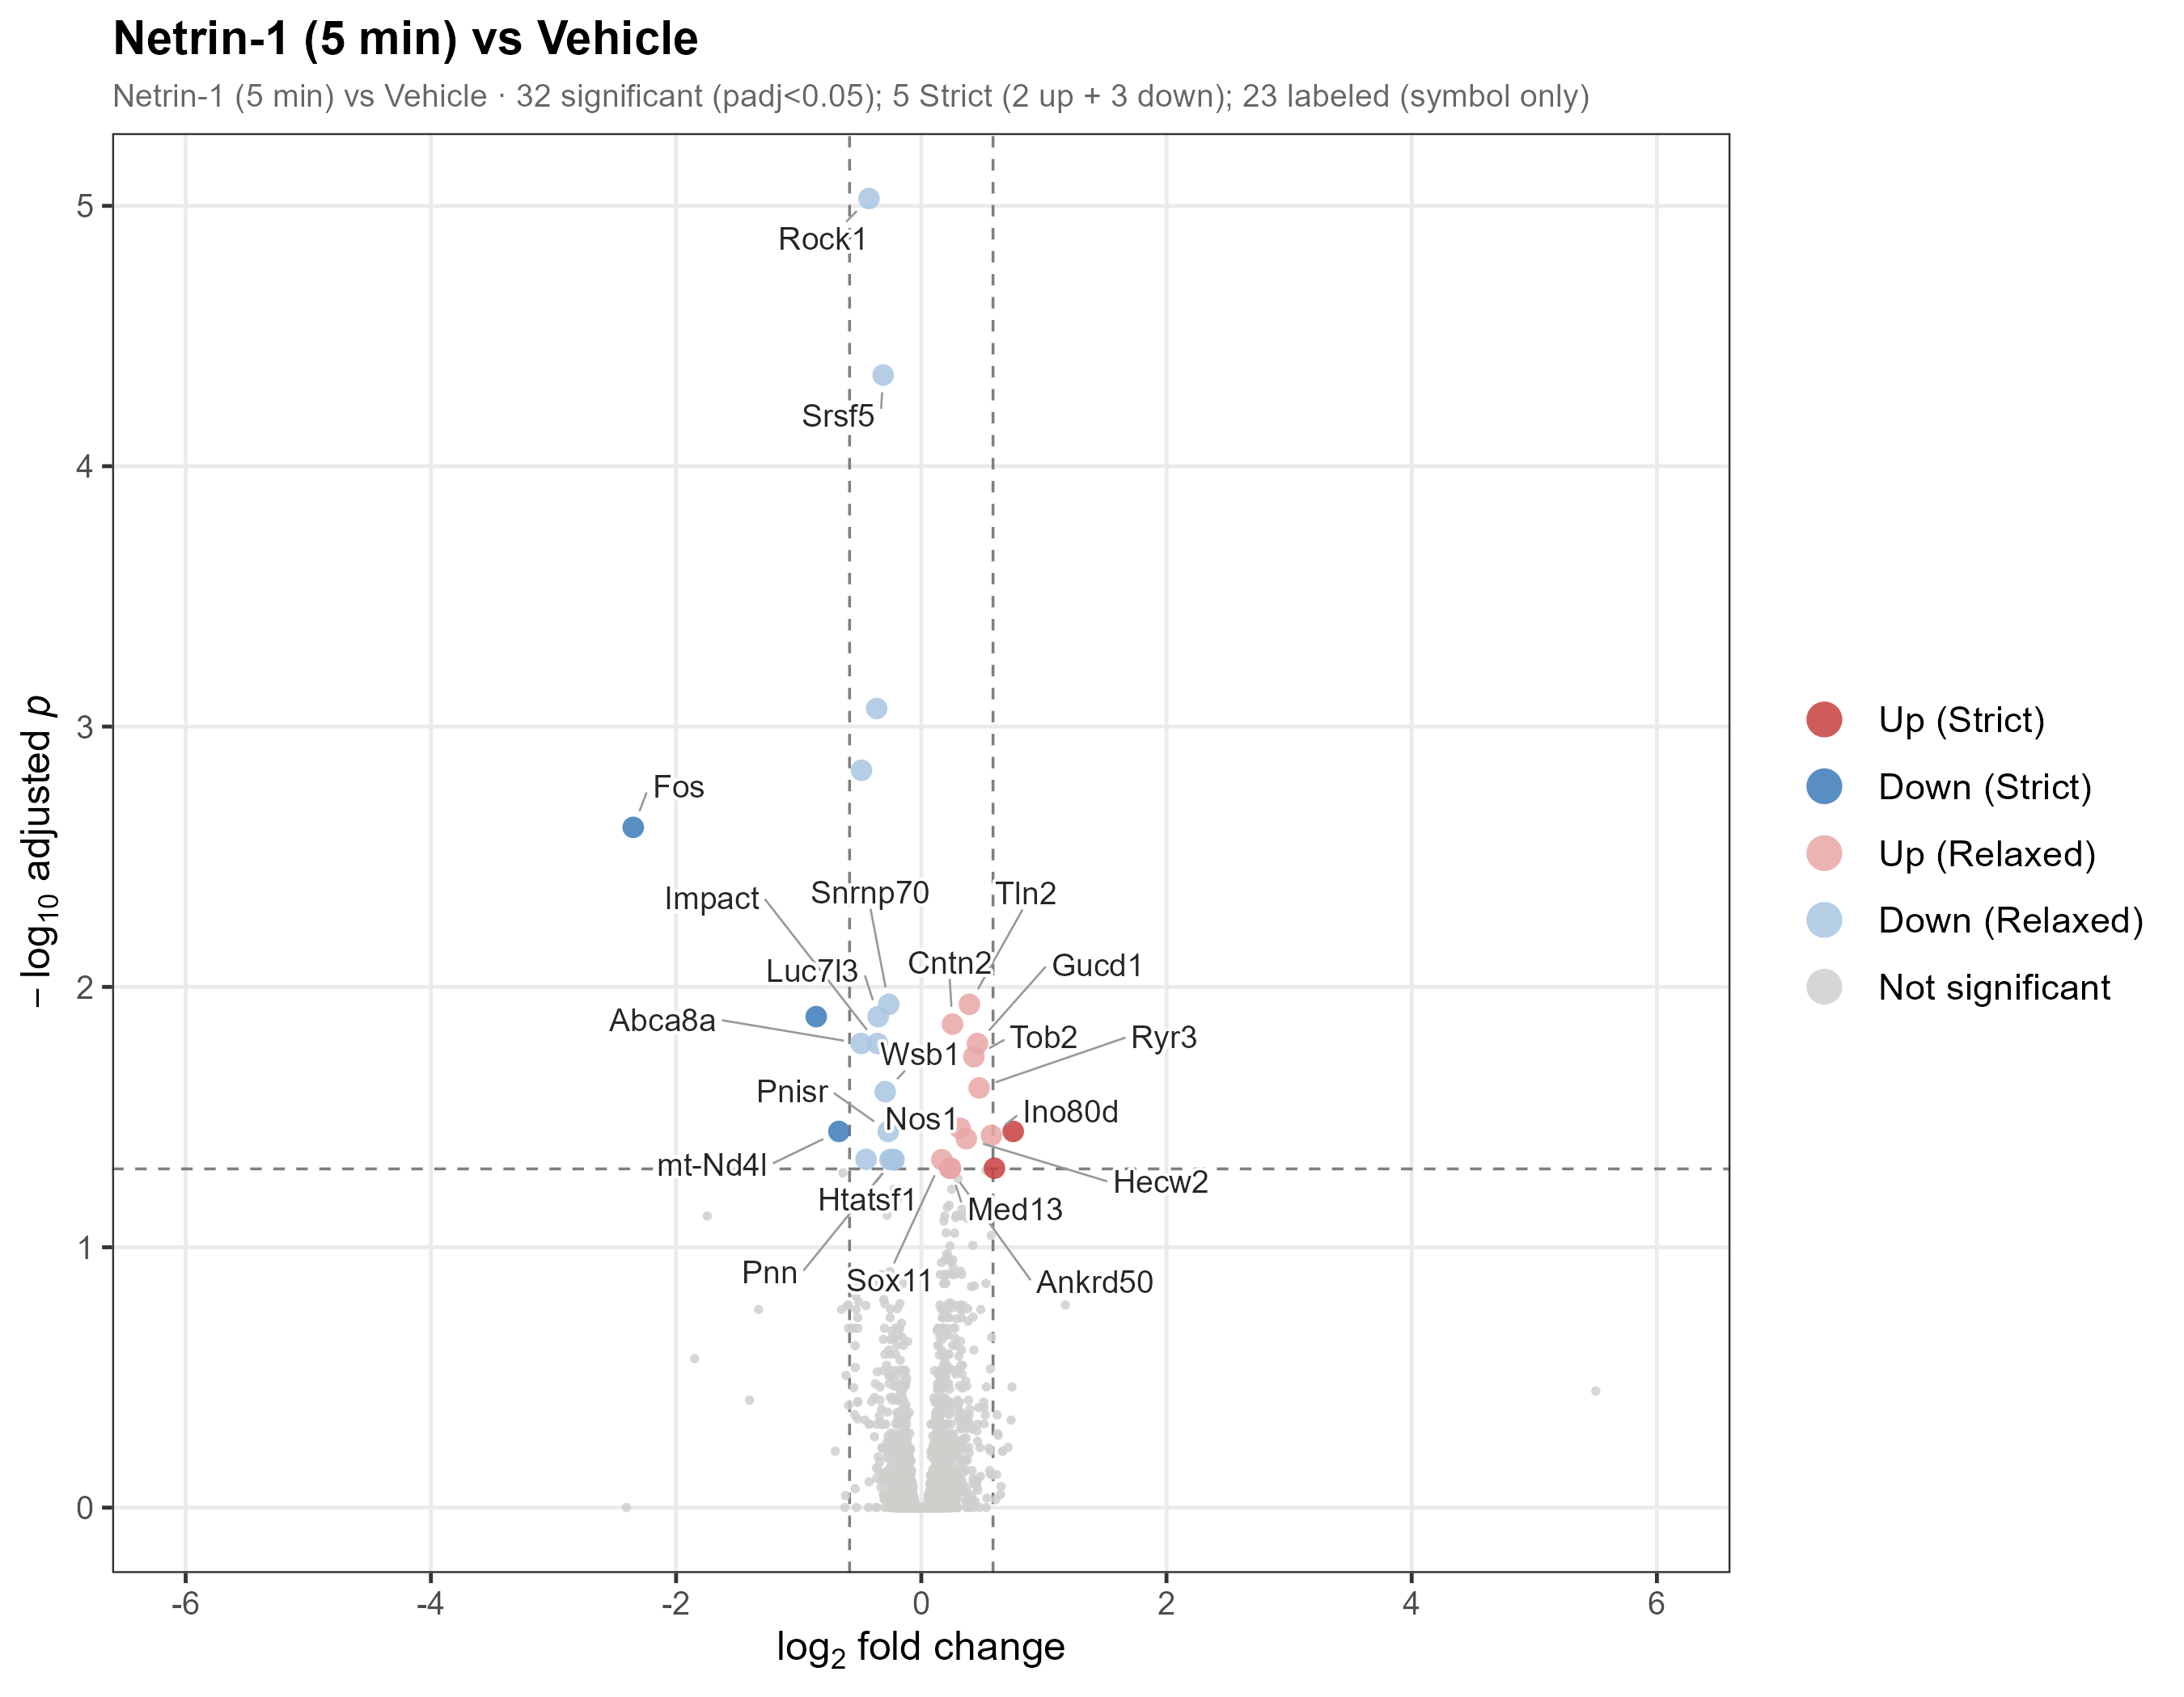
5-MIN DIFFERENTIAL EXPRESSION
The 5-min volcano plot identifies biologically interpretable acute anchors
The small DEG set is coherent rather than random.
Highlighted modules
- IEG suppression: Fos
- Cytoskeleton: Rock1
- Splicing: Srsf5, Snrnp70
- Guidance: Cntn2
- NO-calcium: Nos1, Ryr3
Source: results/03_DEG/04_volcano_5v0_v6.png
07
Notes:
This corresponds to handmade slide 6, but with a conclusion-style title and a cleaner right rail.

Slide 8
KEY 5-MIN GENES
Representative DEGs point to a bidirectional acute program
Guidance/signaling genes rise while IEG and RNA-processing genes fall.
Gene | log2FC | padj | Module
Fos | -2.35 | 2.4e-3 | IEG suppression
Rock1 | -0.43 | 9.4e-6 | cytoskeleton
Srsf5 | -0.31 | 4.5e-5 | splicing
Snrnp70 | -0.27 | 1.2e-2 | splicing
Cntn2 | +0.25 | 1.4e-2 | axon guidance
Nos1 / Ryr3 | +0.32 / +0.47 | 3.5e-2 / 2.4e-2 | NO-calcium
Tln2 | +0.39 | 1.2e-2 | adhesion
Pattern
This table becomes the gene-level bridge into pathway analysis.
Source: DEG_5v0_ALL.csv and handmade slide 7
08
Notes:
This table is intentionally compact and readable at presentation scale.

Slide 9
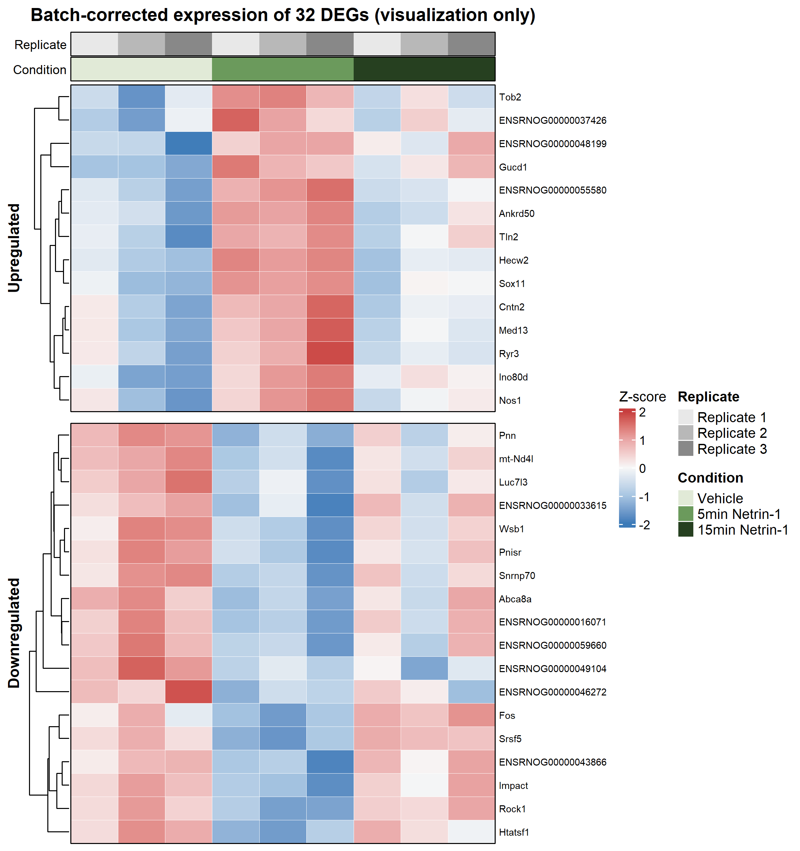
5-MIN DEG HEATMAP
The DEG set forms a coherent sample-level 5-min pattern
This checks whether selected genes move together across samples.
Readout
The heatmap supports a coordinated 5-min expression pattern rather than an isolated single-gene outlier.
Source: results/03_DEG/06_DEG_heatmap_5v0_v4.png
09
Notes:
This replaces the more crowded handmade heatmap slide.

Slide 10
LRT RESULT
The LRT identifies 19 genes with significant time-dependent behavior
For trajectories, row-scaled VST expression is the clearest y-axis.
LRT model
Visualization
19
Full: ~ replicate + timepoint
Reduced: ~ replicate
Y-axis:
Z-score of VST-normalized expression
LRT-significant genes
This makes the LRT slide scientifically explicit: it tests time dependence, not a single pairwise contrast.
Source: DEG_LRT_ALL.csv and LRT trajectory file
10
Notes:
This slide fills the weak handmade LRT slide, which had only a title.

Slide 11
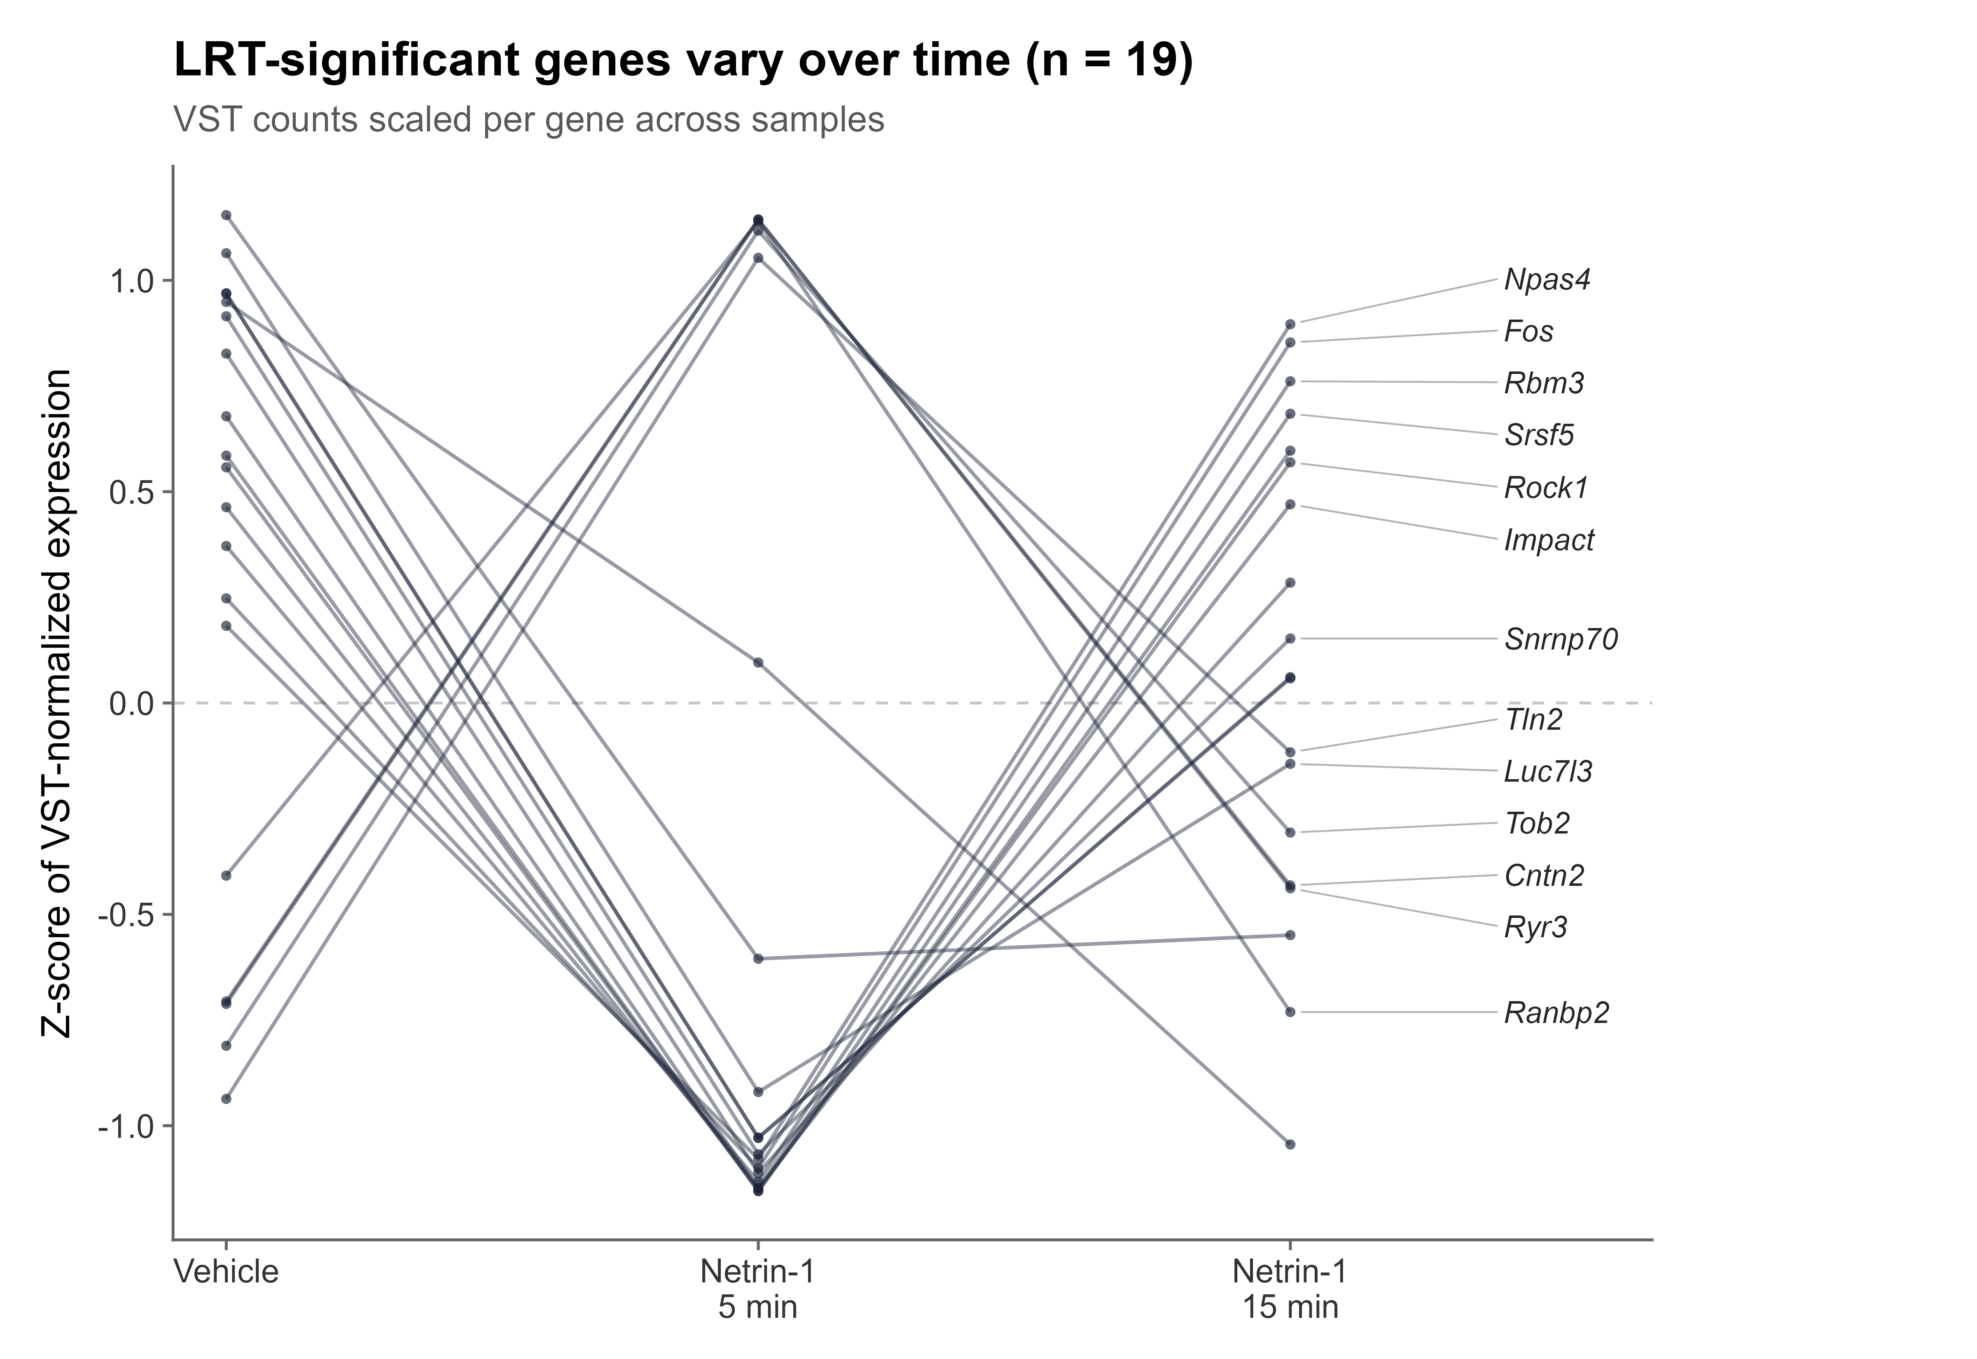
LRT TRAJECTORIES
The 19 time-varying genes show coordinated 5-min deviation and recovery/rebound
The trajectory plot emphasizes shape rather than absolute gene abundance.
Readout
- Rows are genes.
- Values are scaled per gene.
- Most profiles converge on a pulse-like shape.
- Fos/Npas4 support IEG suppression.
Source: results/objects/LRT_19_trajectory_VSTzscore_v1.png
11
Notes:
Use the y-axis wording exactly: Z-score of VST-normalized expression or row-scaled VST expression.

Slide 12
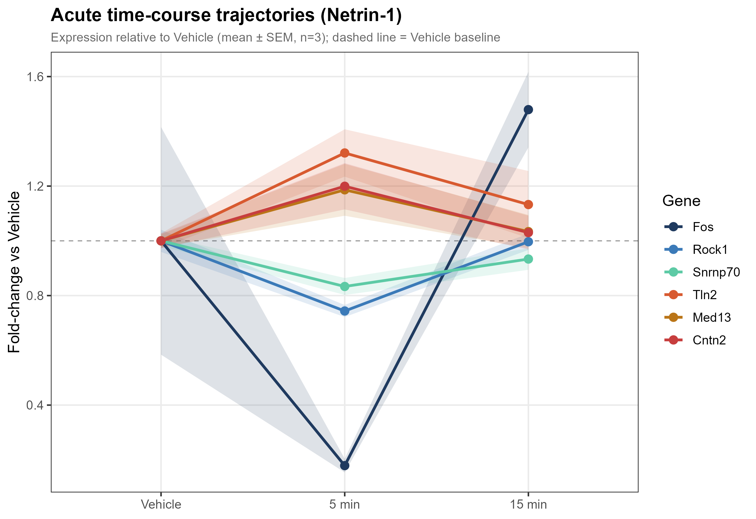
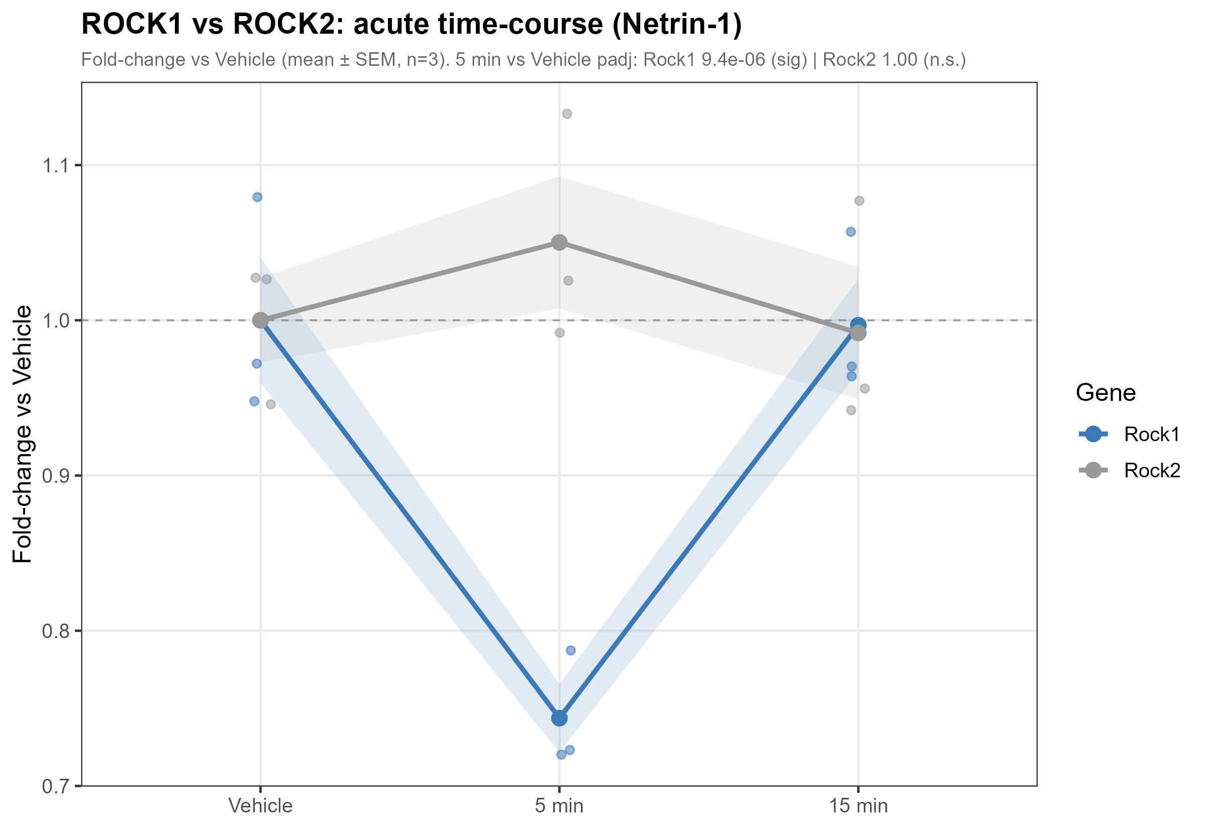
TEMPORAL GENE EXAMPLES
Representative genes and ROCK paralogues support a transient, selective response
This slide keeps the gene-level story compact before moving to pathways.
Rock1 is down at 5 min (padj 9.4e-6), while Rock2 is unchanged (padj ~1.0).
Source: results/03_DEG trajectory plots and handmade slide 8
12
Notes:
This merges two handmade concepts into one better-flowing result page.

Slide 13
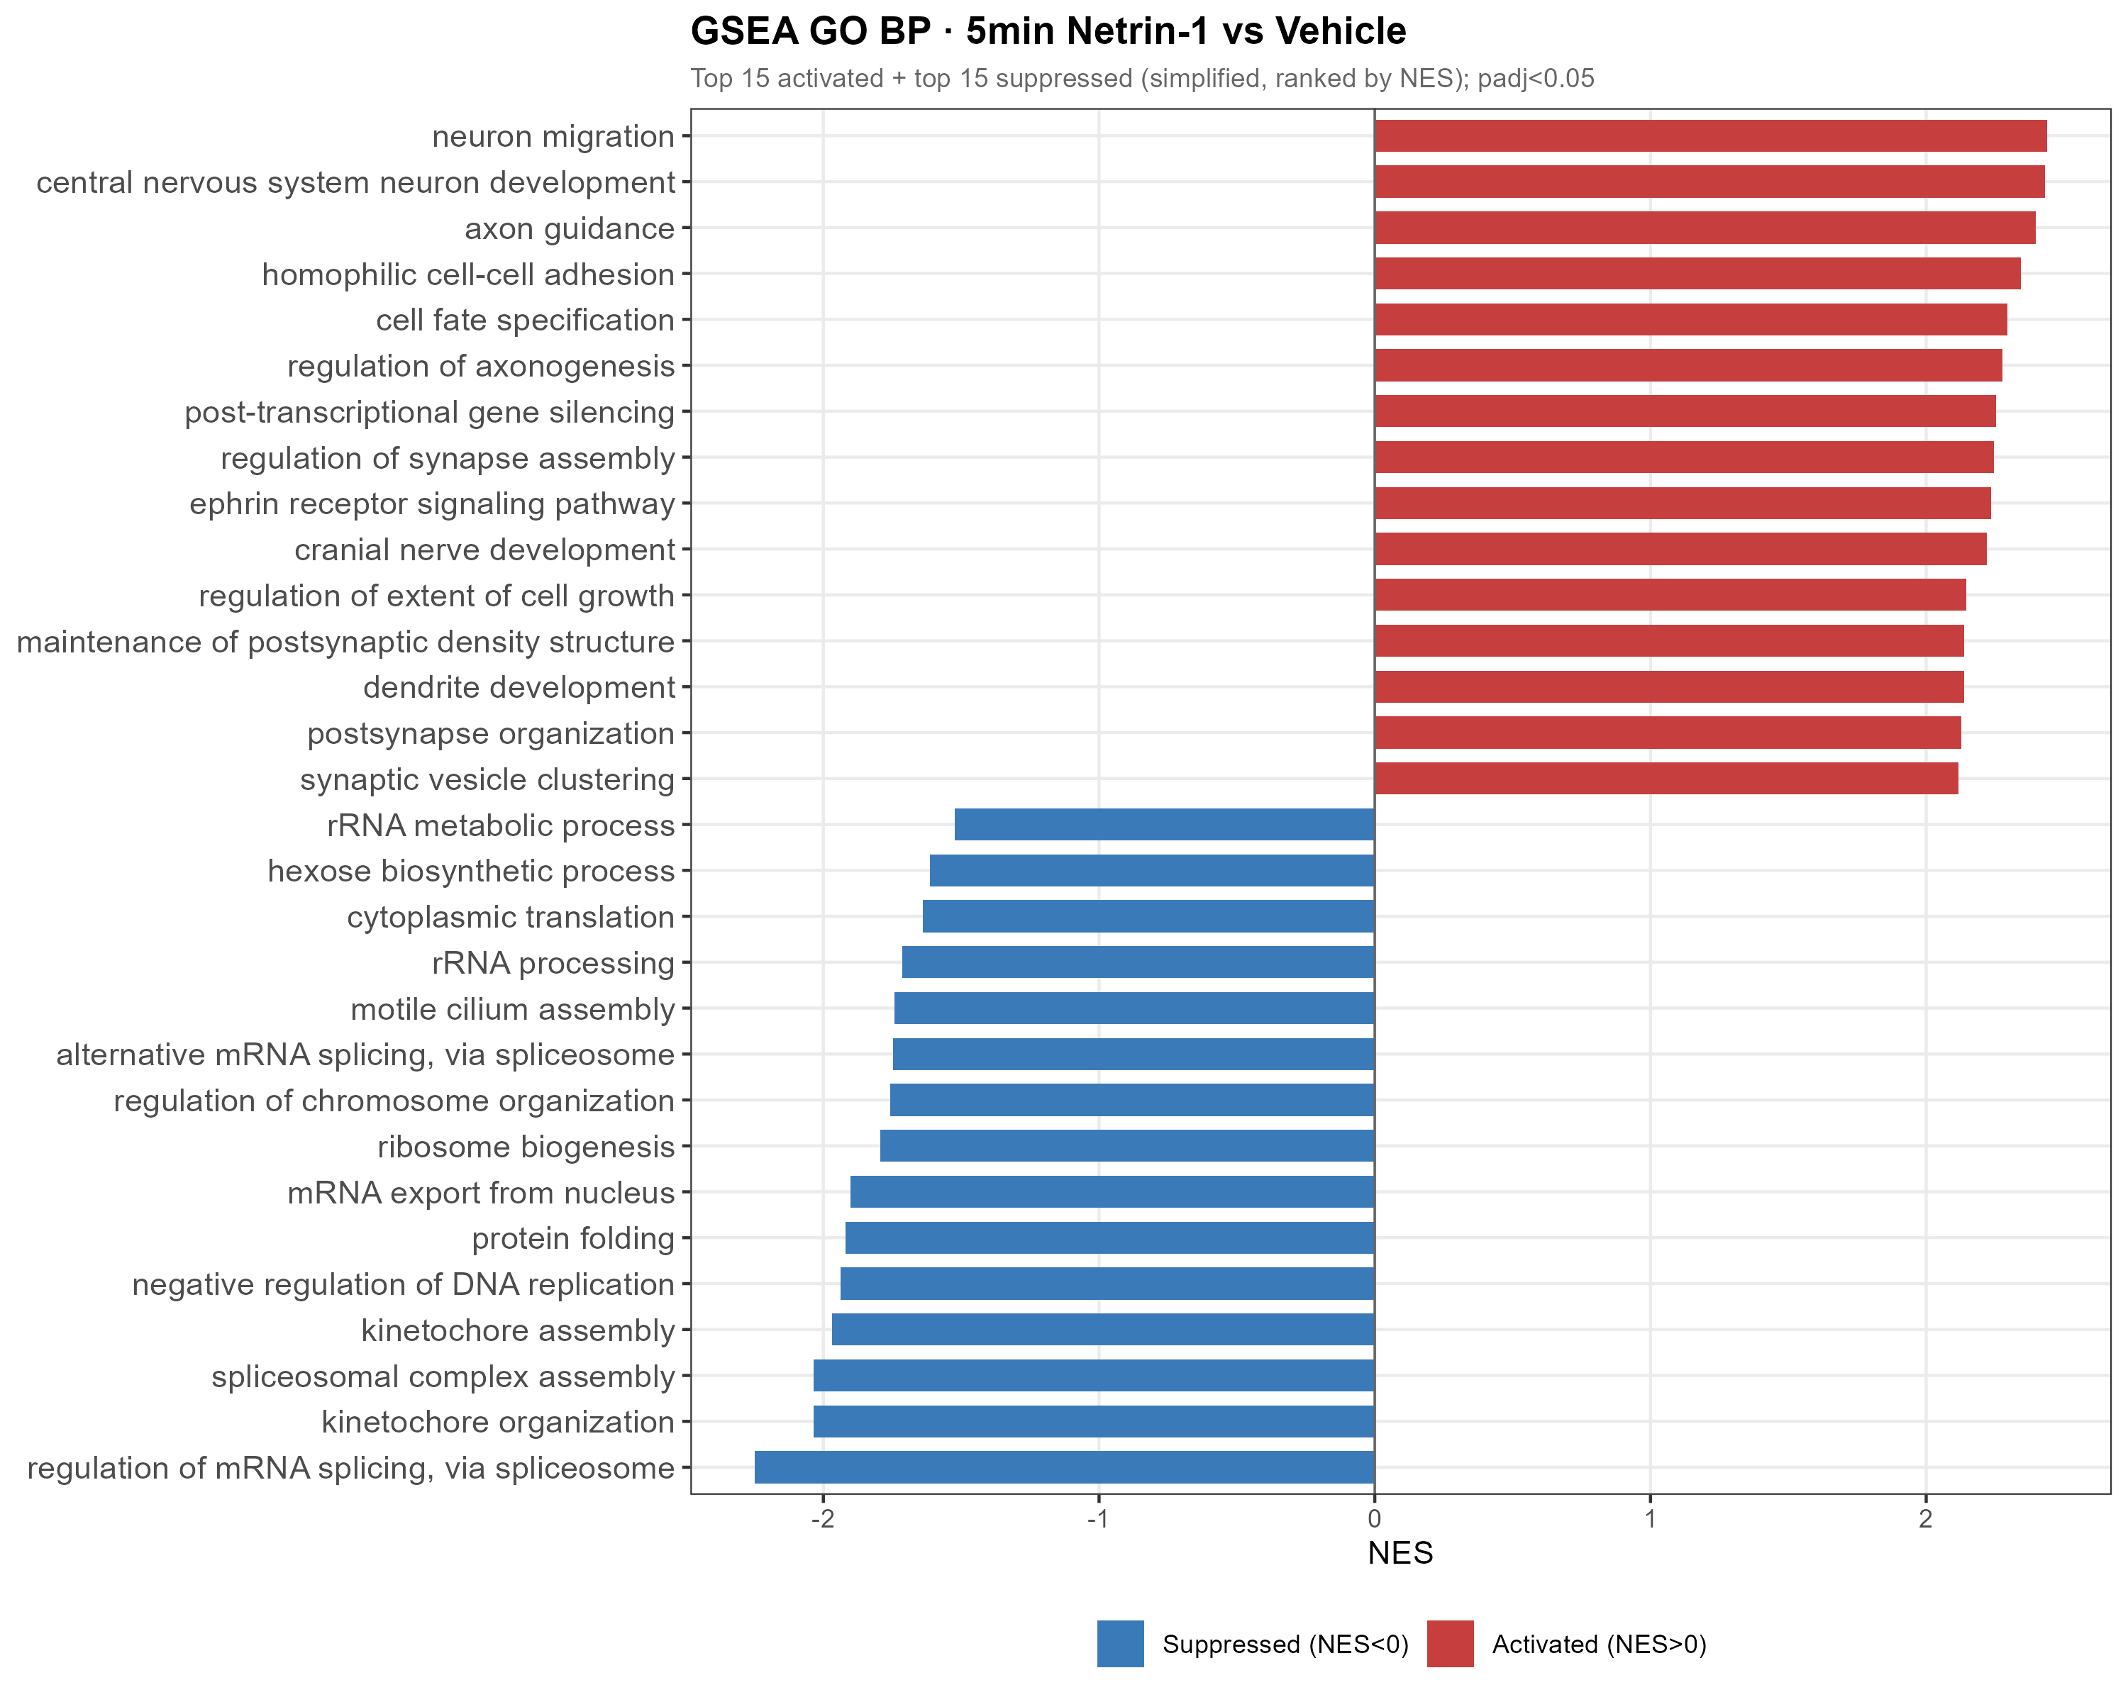
5-MIN GO BP ENRICHMENT
At 5 min, Netrin-1 activates neuron projection and axon guidance programs
Pathway aggregation reveals coordination beyond the modest DEG count.
313
significant GO BP terms
285 up
positive NES terms
Source: results/04_GSEA/GSEA_GO_BP_5v0.csv
13
Notes:
This is the central pathway result from handmade slide 10.

Slide 14
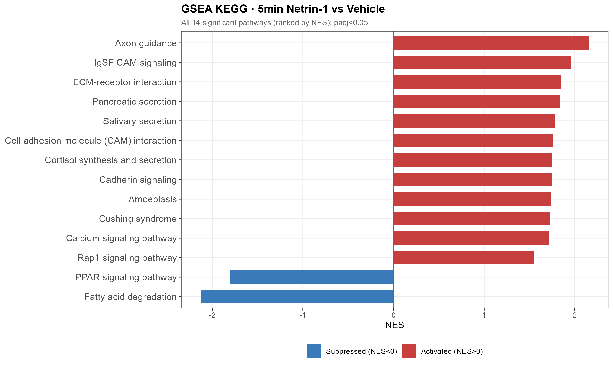
5-MIN KEGG ENRICHMENT
Axon guidance is the top KEGG pathway in the acute response
This connects the RNA-seq signal directly to canonical Netrin-1 biology.
Top KEGG
Axon guidance
NES 2.16
BH-adjusted p = 4.1e-7
Source: results/04_GSEA/GSEA_KEGG_5v0.csv
14
Notes:
This keeps the handmade KEGG result but reduces text clutter.

Slide 15
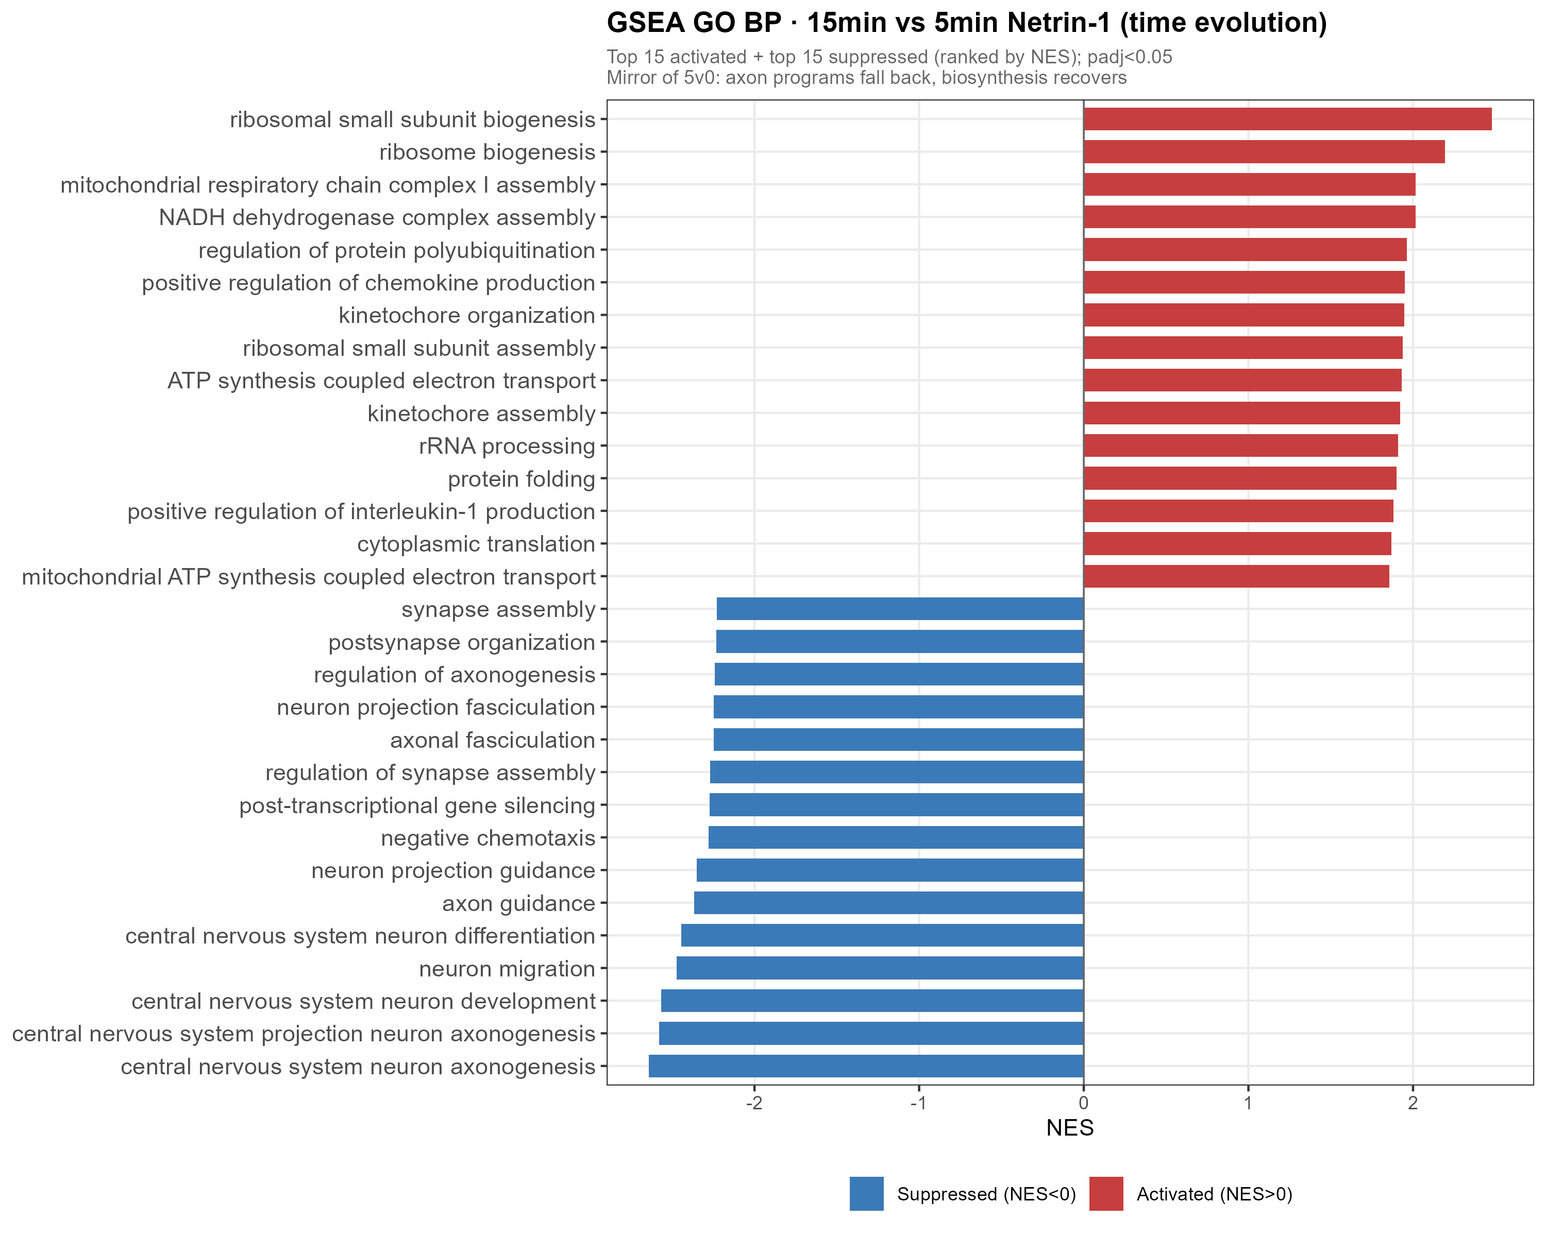
15V5 REVERSAL
By 15 min, the 5-min GO BP program is directionally flipped
The same pathway themes reverse when 15 min is compared with 5 min.
295
significant GO BP terms
264
negative NES terms
Source: results/04_GSEA/GSEA_GO_BP_15v5.csv
15
Notes:
This makes the reversal logic explicit and avoids overcrowding the slide.

Slide 16
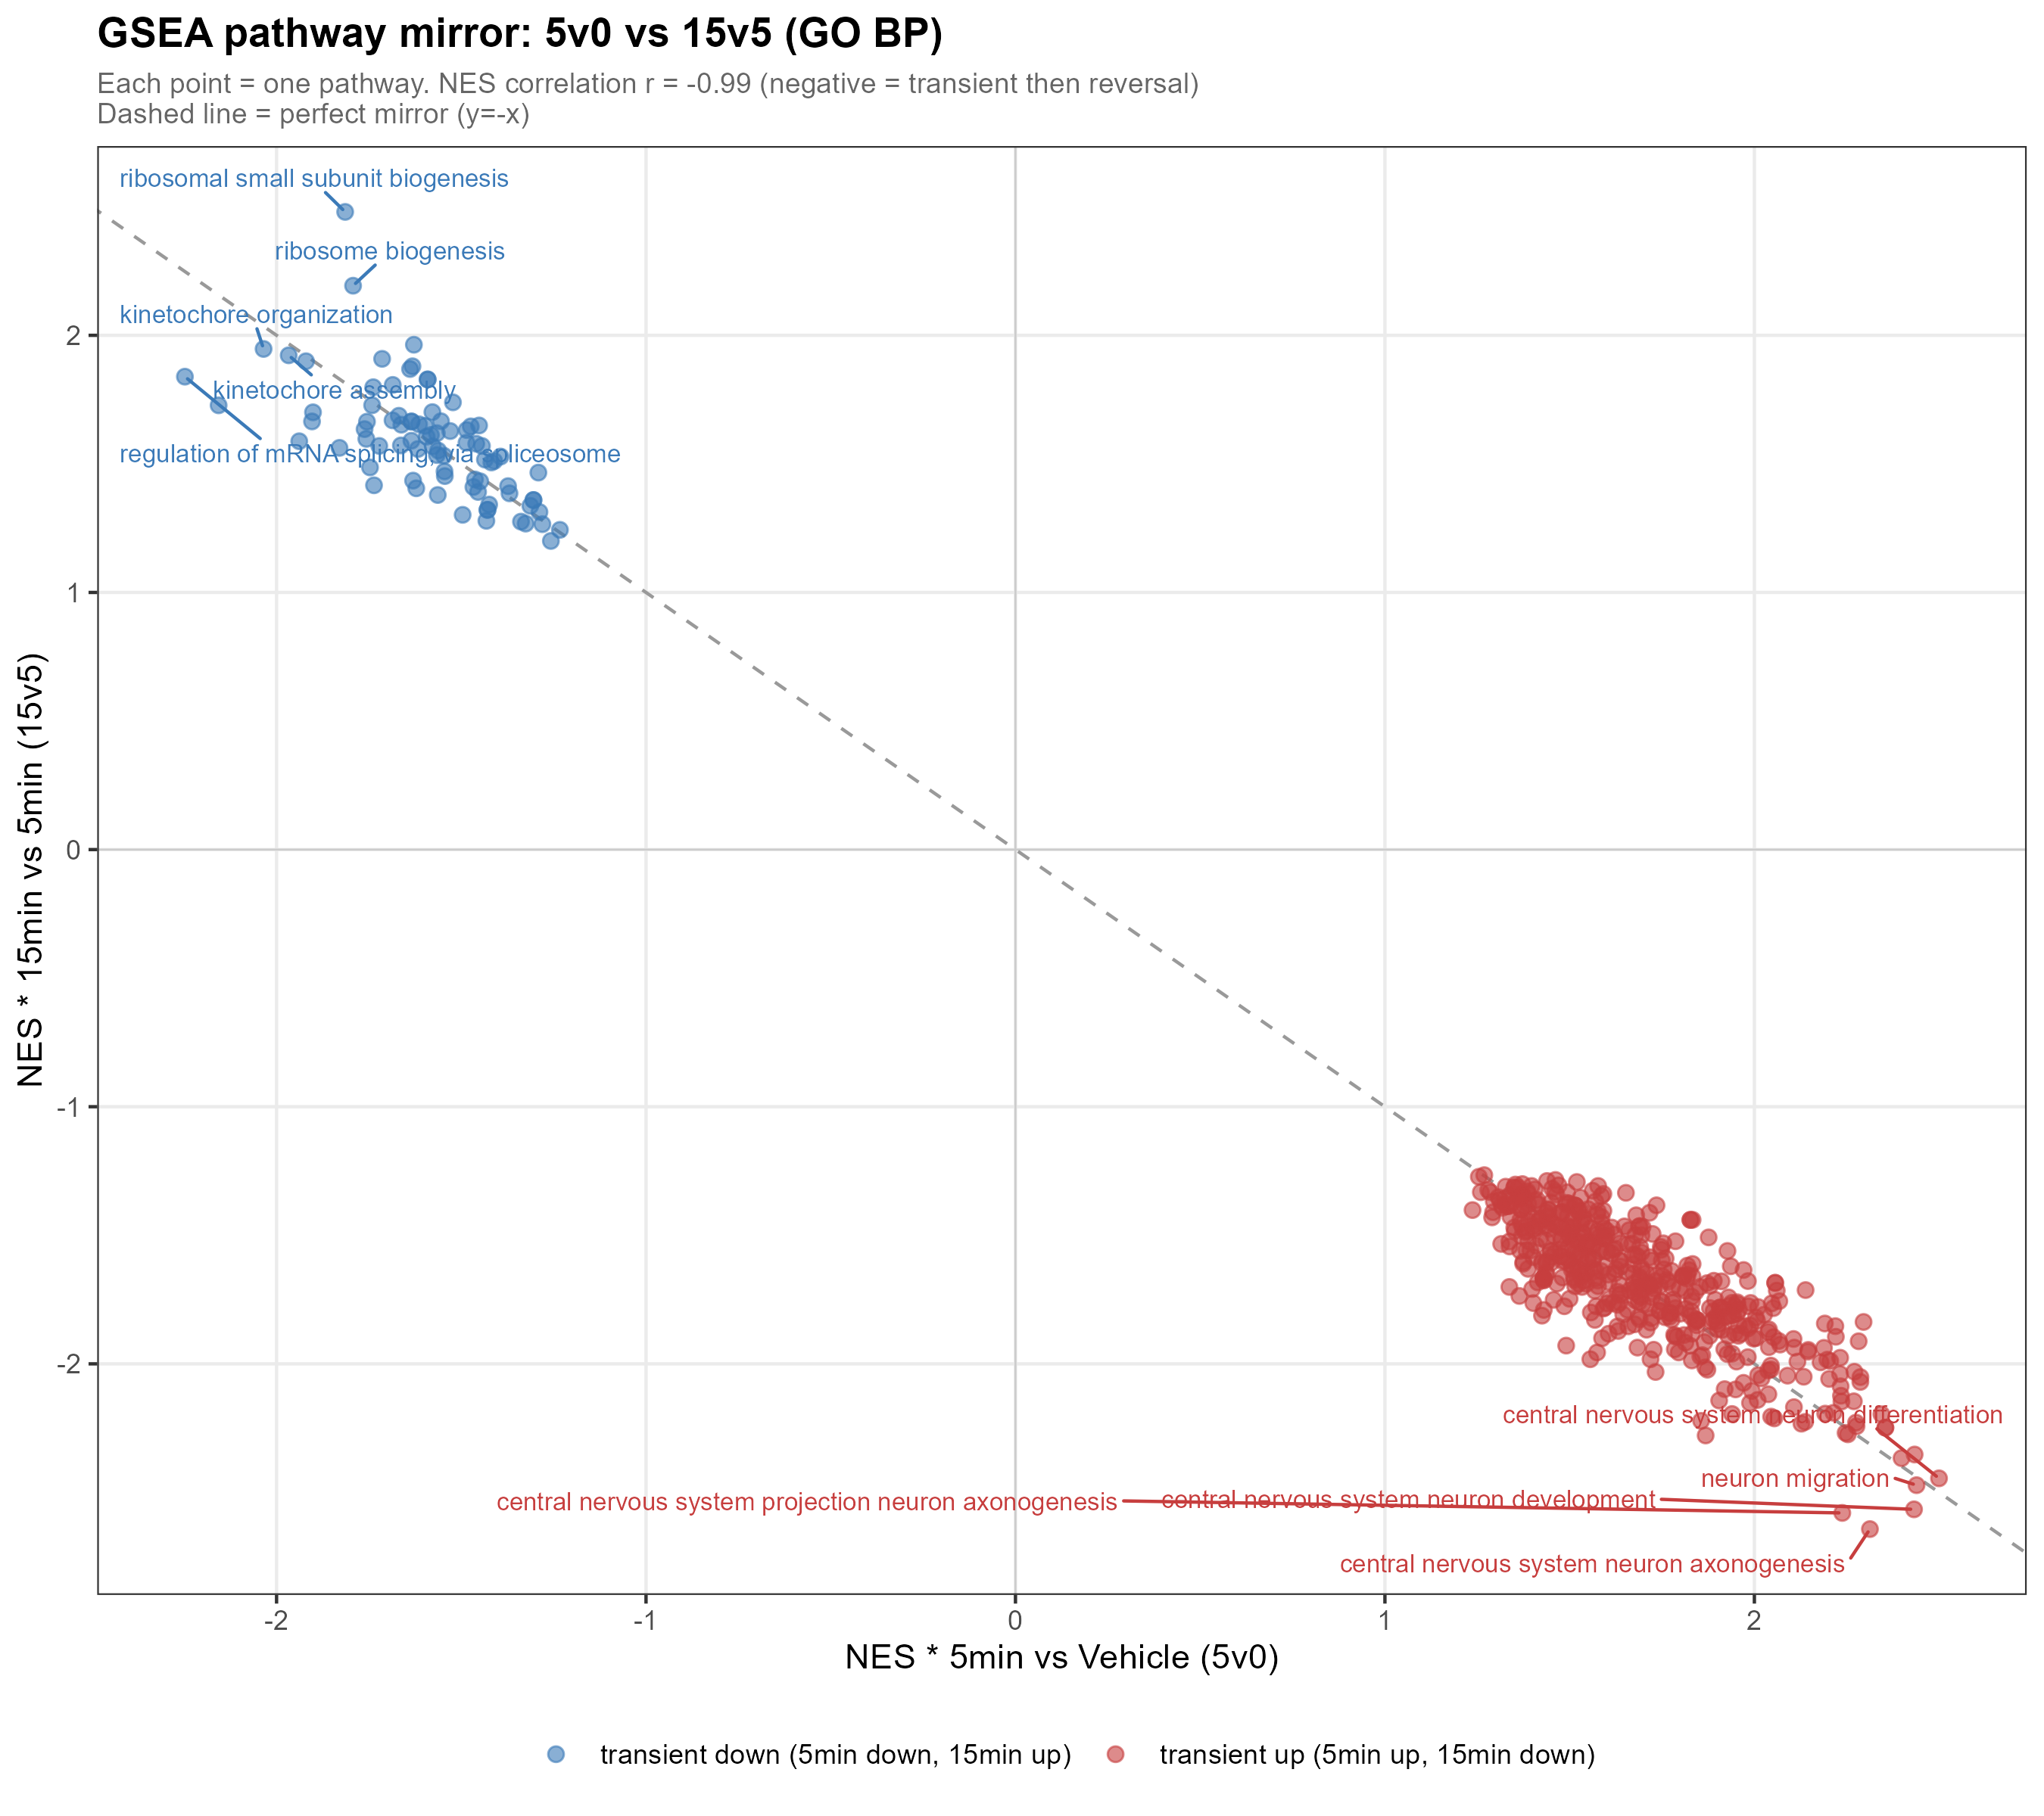
PATHWAY MIRROR
Shared pathways show near-perfect mirror symmetry between 5v0 and 15v5
This is the quantitative anchor for the transient-response claim.
Mirror statistic
603 shared pathways
NES correlation
r = -0.991
Source: results/04_GSEA/13_GSEA_mirror_scatter_5v0_vs_15v5.png
16
Notes:
This should be one of the strongest slides in the results presentation.

Slide 17
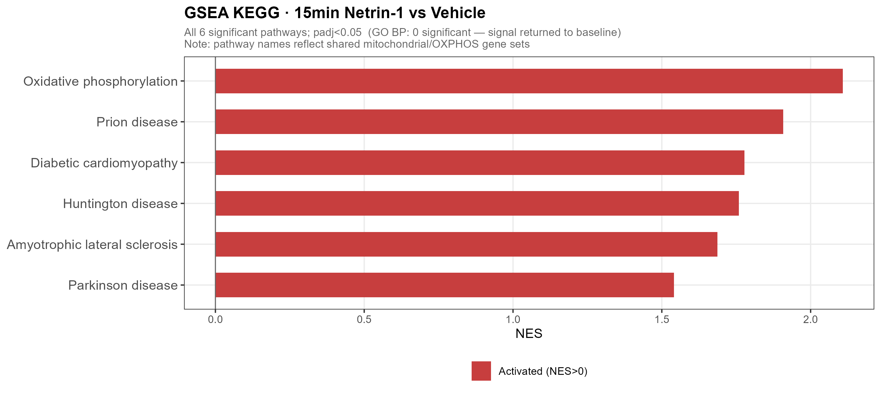
15V0 ENDPOINT
15v0 supports return toward baseline, with a mild mitochondrial KEGG signal
This keeps the interpretation accurate and avoids overclaiming complete silence.
Interpret carefully
- GO BP: 0 significant terms
- DEG: 1 significant gene
- KEGG: OXPHOS/mitochondrial signal
- Disease labels reflect shared mitochondrial genes
Source: GSEA_GO_BP_15v0.csv and GSEA_KEGG_15v0.csv
17
Notes:
This slide is scientifically important because it states the caveat clearly.

Slide 18
INTEGRATED RESULT
Acute Netrin-1 engages a reversible transcriptional program
The result is strongest when DEG, LRT and GSEA are interpreted together.
5-min pulse
Netrin-1
>
>
15-min reversal
guidance / projection up
RNA processing / ribosome down
IEG suppression
acute cue
pathway mirror r = -0.991
Take-home: the 5-min signal is modest at the DEG level but highly coordinated at the pathway level, and it is rapidly reversed by 15 min.
Integrated from DEG, LRT and GSEA result files
18
Notes:
End the results showcase with one clean model rather than a long discussion.

